Slide 1

Artificial Intelligence (CSE 412)
Topic – 3C: Network Architecture
Department of CSE
Daffodil International University

Slide 2
Topic Contents
Overview
Definition
Types
Layered Architecture
Some Important Types
The XOR Problem Revisited

Slide 3
Definition
Network architecture is an important factor in network functioning and learning.
So the networks we want to consider must be defined in a more precise way in terms of their architecture.
The atomic elements of any architecture are the computing units and their interconnections.
Network architecture refers to the way the computing units of a neural network are connected.

Slide 4
Types
Two major types of network architecture are feedforward and feedback.
In a feedforward architecture, the connections between computing units do not form cycles. Feedforward neural networks usually produce a response to an input quickly.
In a feedback or recurrent architecture, there are cycles in the connections. In some feedback neural networks, each time an input is presented, the neural network must iterate for a potentially long time before it produces a response.
Feedback neural networks are usually more difficult to train than feedforward neural networks.

Slide 5
Layered Architecture
Layered architectures are those in which computing units are partitioned into subsets called layers, with no connections that lead from layer j to layer k if j > k, as shown in Figure 1.13 (next slide).
We adopt the convention that a single input arrives at and is distributed to other nodes by each node of the "input layer" or "layer 0"; no other computation occurs at nodes in layer 0, and there are no intra-layer connections among nodes in this layer.
Connections, with arbitrary weights, may exist from any node in layer i to any node in layer j for j > i; intra-layer connections may exist.

Slide 6
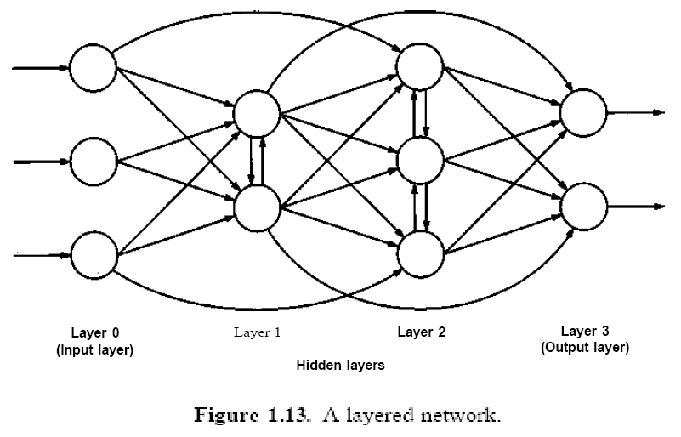
Layered Architecture

Slide 7
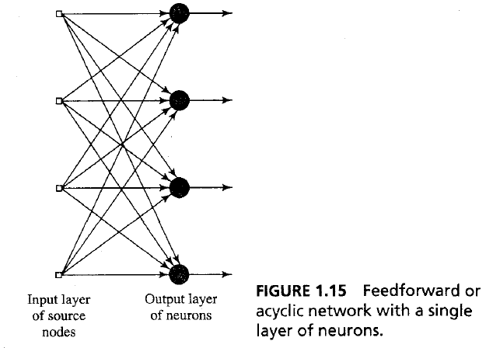
Some Important Types
Single-Layer Feedforward Neural Networks:

Slide 8
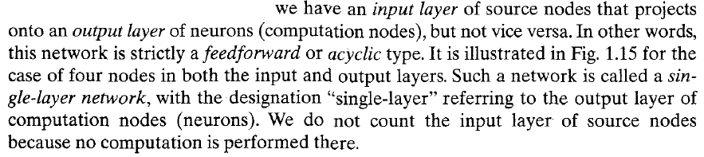
Some Important Types
Single-Layer Feedforward Neural Networks:

Slide 9
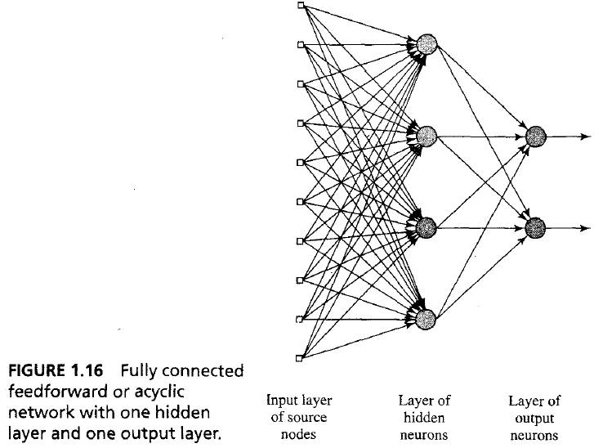
Some Important Types
Multilayer Feedforward Neural Networks:

Slide 10
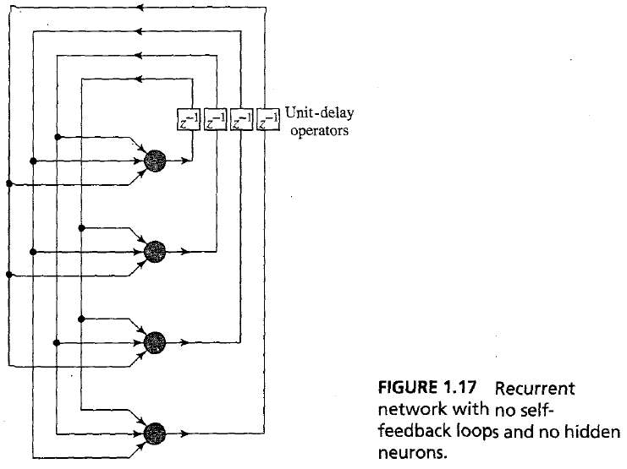
Some Important Types
Feedback or Recurrent Neural Networks:

Slide 11

